Slide 1
TA Advisor Output scenarios

Slide 2
Interpretations from TAOutput Data
Observations related to different color code/complexity score of TA advisor:
Issues with a SIMPLE complexity rating can be resolved by making administration changes
Issues with a MODERATE complexity rating can be resolved by making development changes
Issues with a COMPLEX complexity rating can be resolved by making significant development changes or by choosing an alternate technology
Even though color code is green still some admin task needed to configure (can be identified based on complexity Rule)

Slide 3
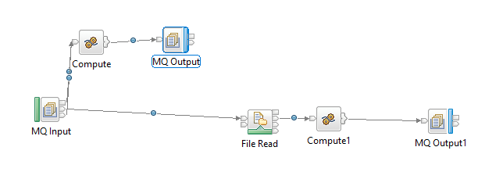
MQ And FTP
html output
Observation:
Only MQ information is displayed in output, no info about FTP
Node
Impact:
This will impact the configuration that needs to be set while
Deploying into CP4I region
JSON output
Bar file

Slide 4
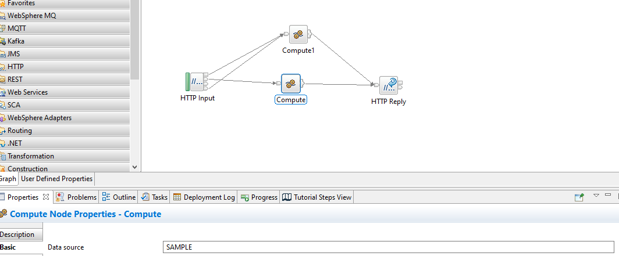
DB Connection Flow (ODBC)
html output
Observation:
Even though an ODBC connection has been configured no
information about the DB connection is displayed in TA Output
Impact:
This will impact the configuration that needs to be set while
Deploying into CP4I region
JSON output

Slide 5
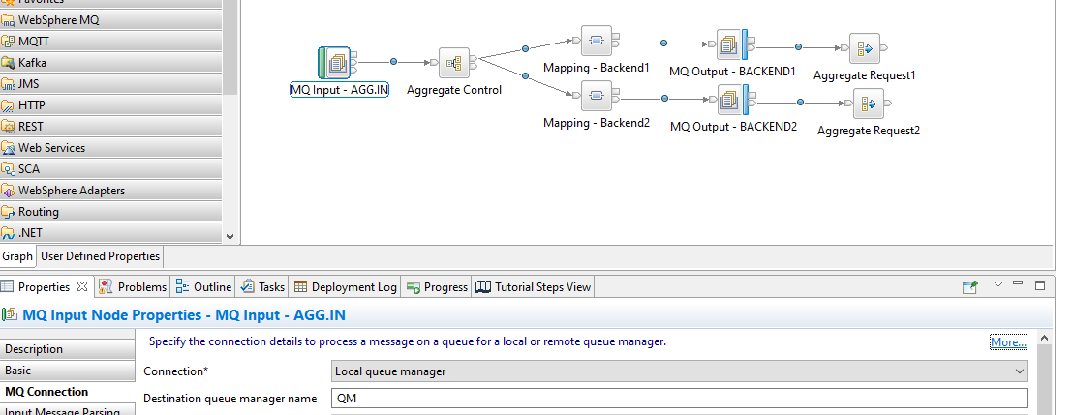
Aggregate & MQ Node
HTML output
Observation:
Output of TA is sufficient to proceed with change
JSON output
Bar file

Slide 6
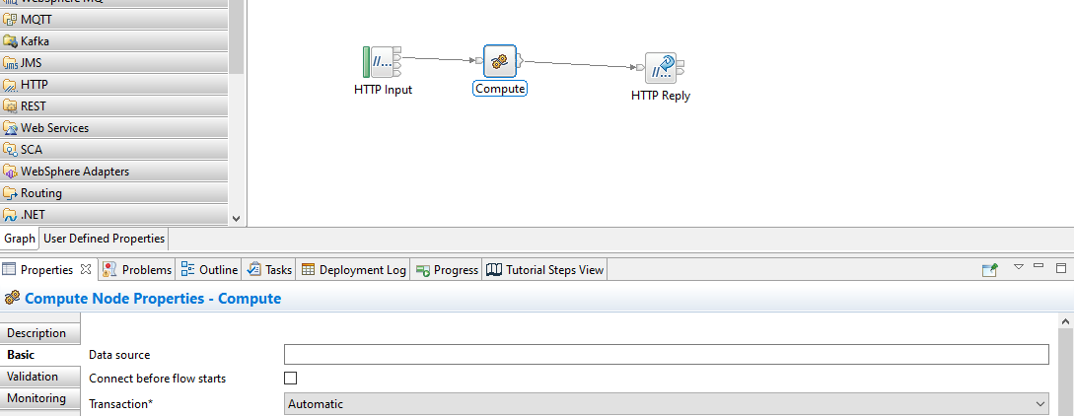
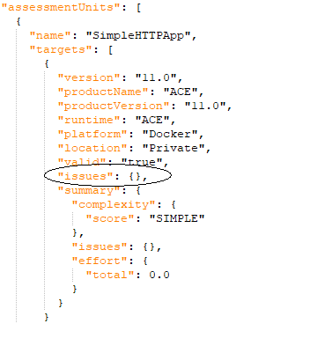
Simple Webservice Flow
Observation:
The below highlighted JSON path can help us to decide
To directly deploy the flow or need modifications
HTML Output
JSON Output
Bar file

Slide 7
TA Output via integration nodes
Configurable services defined at Integration node level will be captured only when we run TA against back up of Integration node. It will not identified against bar file

